Slide 1
Introduction
Housekeeping Coordinator
Carolina Johnson
Poor Housekeeping Pilot Program

Slide 2
The Poor housekeeping Coordinator is the liaison between site staff and the Resident Service Coordinators
To assist with helping the Resident Service Coordinators visit and speak to the residents.
To provide training on how to maintain and upkeep their homes
To help decrease rodent issues
Improve our REAC scores
Decrease in cost to turn a vacant unit
PURPOSE OF THE PROGRAM ​

Slide 3
Housekeeping Video

Slide 4
By: Carolina Johnson

Slide 5
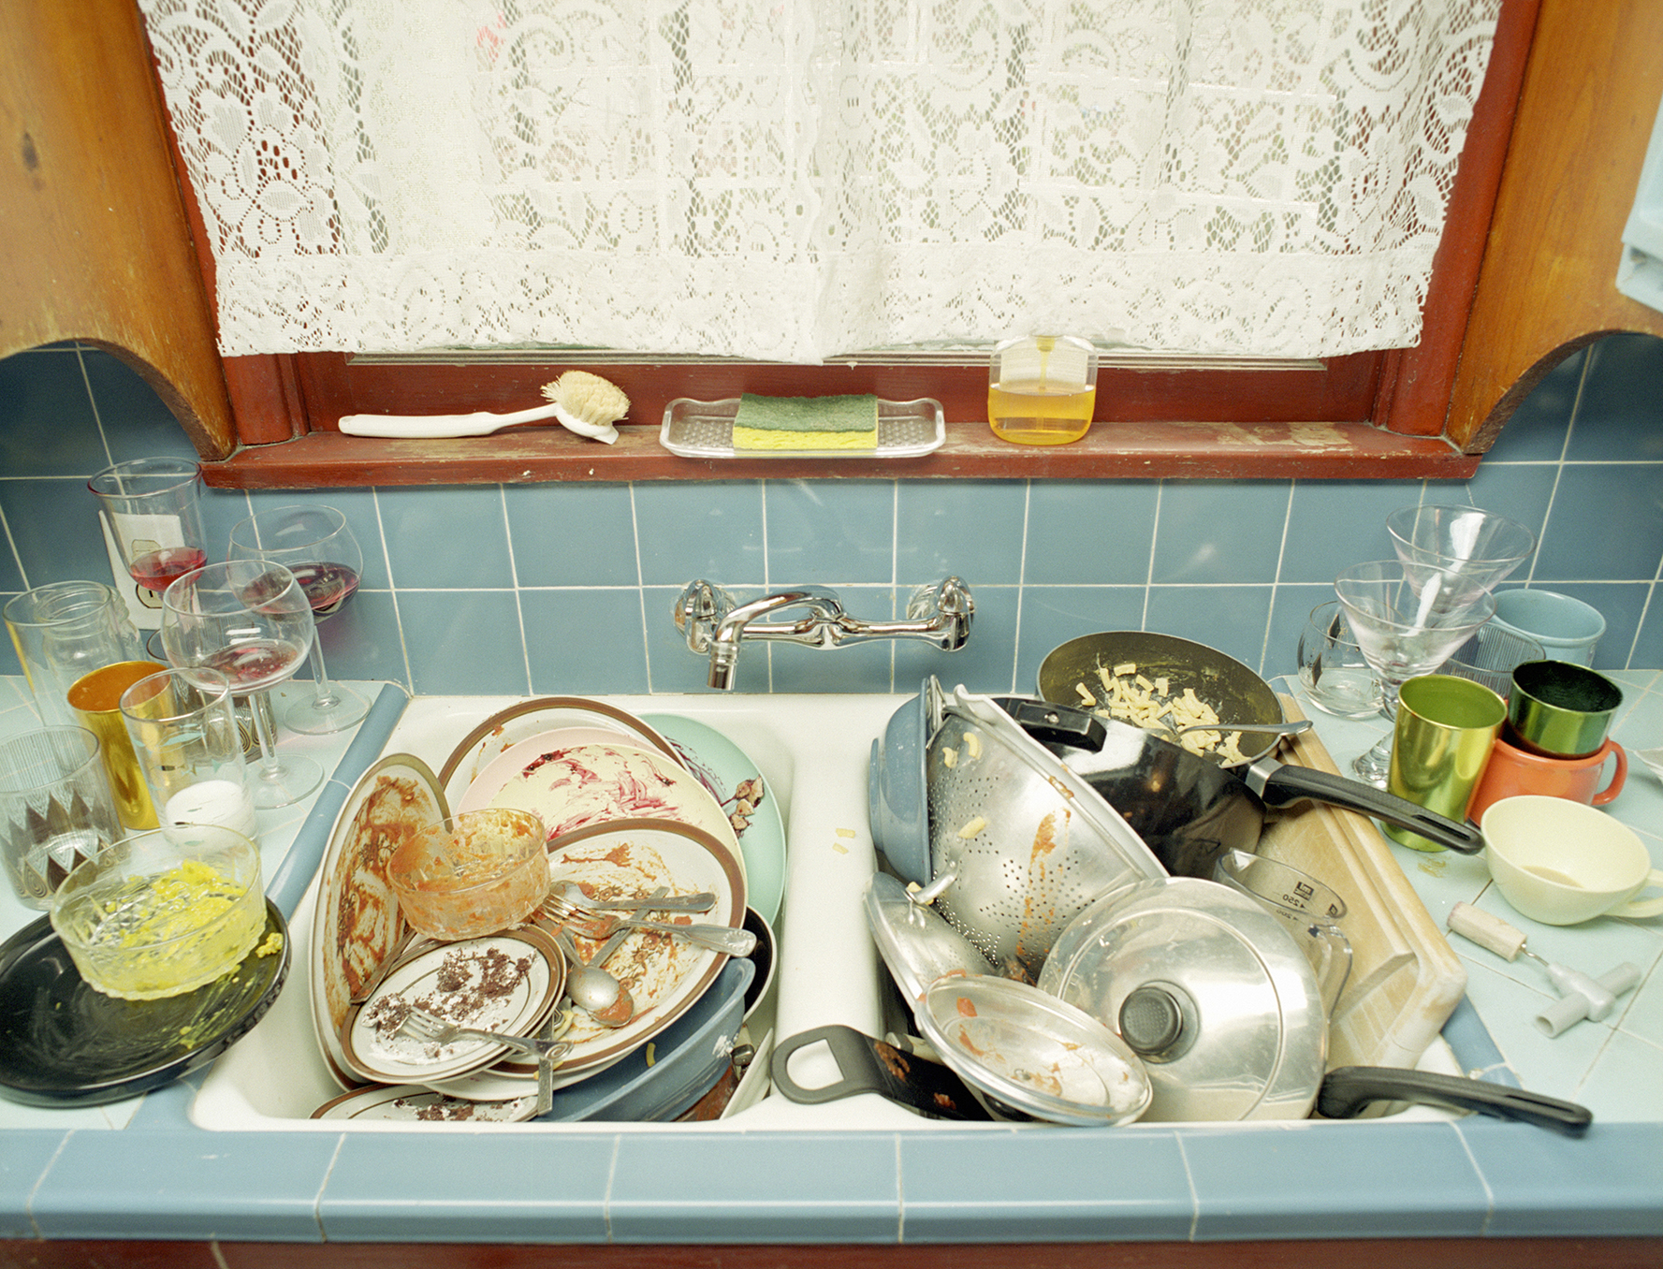
How to Prevent bugs & Pest in your Home
Pets
Do not leave pet food out.
Store the pet food in a sealed container.
Clean cat litter box
Pick-up your dog’s poop

Slide 6
Kitchen
Limit where you eat. Make a rule that eating is only done in the kitchen and dining areas. The fewer areas that have been exposed to crumbs and food residue, the less risk of an invasion you'll have.
Clean the floor daily. Whether you choose to sweep or vacuum, clean the floor daily. Food and residue need to be removed quickly so that bugs won't be attracted to the mess. Missing a day may be just enough to attract some unwanted visitors to an unintended feast.
Tackle spills quickly. Just as your messy floor can become an invitation to pests, spilled areas throughout the kitchen can beckon to bugs. Be sure to move furniture and appliances to be sure all the residue of a spill has been cleaned.
Wash dishes. Waiting to wash the dishes isn't a great idea. Even soaking dishes can be an attraction for bugs if they are left for an extended period of time. When dishes are washed, be sure to drain any dishwater, and wipe down the sink.
Clear the drain. Be sure that any slow-moving drains are cleared and cleaned. Many bugs come indoors searching for water. Be sure to repair any leaky sinks and drains in your home.¹

Slide 7
Pantry
Pantries
Wipe down bottles. After a bottle or jar has been used, be sure to wipe down the outside of the bottle and the lid. Residue on your honey, syrup, oil, and peanut butter containers can be a big attraction to bugs.
Store food properly. Bugs can get into all but the most tightly sealed packaging. Be sure to store items in the pantry in containers that properly seal. Consider removing many of your dry goods like sugars, flours, and bulk mixes in airtight containers. Even more frequently used items like cereal, pasta, and pet foods should be in containers that are fully resealable.
Watch out for fruits and vegetables. Of course, fresh fruits and vegetables are great for our nutrition, but they can be a pain in the pantry if they are anywhere near spoiling. Use or throw out fruits and vegetables that are past their prime. Those ripe fresh foods will attract ants, fruit flies, and many other pests.¹

Slide 8
Clothes & Closet
Clothes Closets
Clean clothes before storing. Clothes that are dirty will attract bugs. So before throwing all the winter coats into the back of your closet, take the time to have them dry cleaned or washed before being stored. Storing clothes in properly sealed containers will also go a long way towards preventing an infestation.¹

Slide 9
Garbage Bins
Clean out the recyclables. Be sure to rinse out plastic, glass, and metal containers that are being recycled.
Clean garbage containers. Washing down the insides and outsides of your trash and recycling containers is a monthly job. We find it easiest to do this chore outside with a garden hose and a long-handled scrub brush. We recommend having a separate toilet brush that works well at cleaning the hard-to-reach areas of the trash cans.
Put a lid on your trash. Lids on trash will keep bugs out, keep smells in, and keep infestations away. Choose bins and buckets with lids when shopping for garbage and recycling containers.¹

Slide 10
Outside Areas
Avoid standing water. Holes that fill up with water, children's toys, and even birdbaths can be breeding grounds for bugs. Fill in or remove places that might fill up with rainwater. For birdbaths, consider draining and refilling weekly to prevent pests.
Check your screens. Repair or replace broken screens on windows and doors. Add screens to any windows and doors that may be missing them.¹

